Slide 1

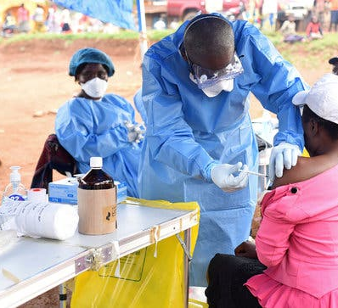
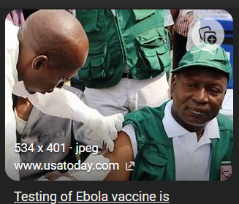
Engagement communautaire pour améliorer la demande a la vaccination des professionnels de santé & des travailleurs de 1ere ligne. Reunion des directeurs du PEV, 9 - 12 Septembre 2024, Kinshasa
Social and Behavior Change (SBC) - Immunization Demand
UNICEF Regional Office, WCAR, Dakar

Slide 2
Plan
Introduction/Contexte
Importance de la vaccination pour les professionnels de santé et de première ligne
Défis actuels
Les raisons courantes de l'hésitation à se faire vacciner contre le virus Ebola chez les travailleurs de première ligne et les professionnels de la santé
Quelques stratégies pour réduire l’hesitation
La vaccination des professionnels de santé renforce la confiance au sein de la communauté
Exemples de stratégies d'engagement communautaire réussies pour le vaccin contre Ebola parmi les professionnels de santé ou les travailleurs de première ligne
Domaine de messages clés pour les professionnels de santé concernant le vaccin
Stratégies pour atteindre et impliquer efficacement les travailleurs de première ligne
Appel à l'action : Importance des efforts soutenus et de la communication continue
Exemples de materiels de communication pour sensibiliser les professionnels de sante
Conclusion & quelques ressources

Slide 3

La perception en communication

Slide 4
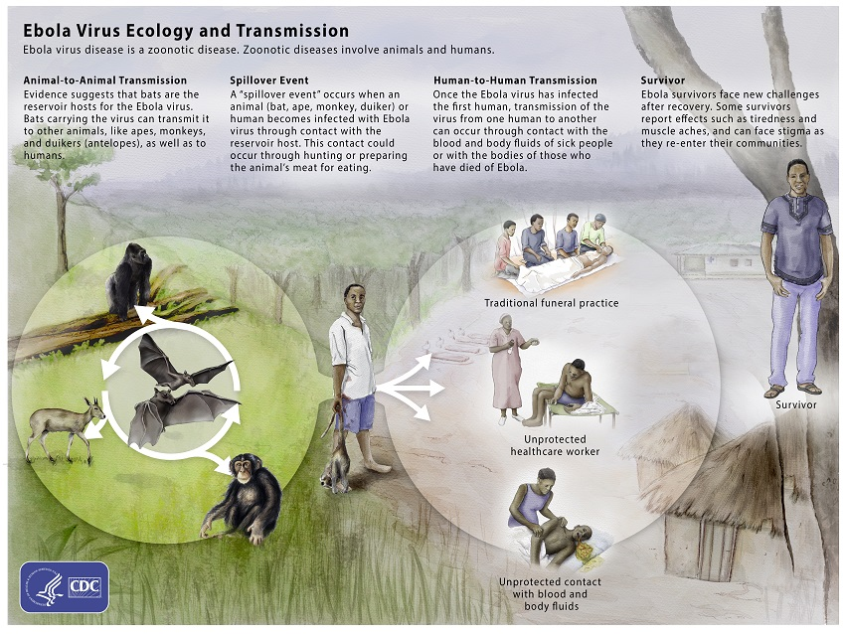
Importance de la vaccination pour le personnel de sante et les travailleurs de 1ere ligne
Brief overview of the Ebola virus disease (EVD)
Risque d'exposition Prévention de la transmission Maintien de la capacité des soins de santé Protection des travailleurs de première ligne Confiance du public et leadership Préparation à une pandémie
Notes:
Risk of Exposure: Healthcare workers are at the frontline of treating patients with Ebola virus disease (EVD). They face direct exposure to bodily fluids of infected individuals, which puts them at high risk of contracting the virus.
• Transmission Prevention: Vaccinating healthcare workers helps prevent transmission within healthcare settings. By reducing the risk of infection among healthcare providers, the spread of Ebola to other patients and community members is mitigated.
• Maintaining Healthcare Capacity: During Ebola outbreaks, healthcare systems are often overwhelmed. Vaccinating healthcare workers ensures that essential medical services can continue without interruption, as vaccinated workers are less likely to become ill and require medical care themselves.
• Protection of Frontline Workers: Frontline workers such as first responders, community health workers, and volunteers are also at increased risk due to their direct contact with affected communities. Vaccination protects these individuals, allowing them to safely carry out their critical roles in outbreak response.
• Public Confidence and Leadership: When healthcare and frontline workers receive the vaccine, it demonstrates confidence in the vaccine's safety and efficacy. This leadership by example can encourage broader community acceptance of vaccination programs.
• Pandemic Preparedness: Ebola outbreaks can escalate rapidly, and preparedness is key to controlling them. Vaccinating healthcare and frontline workers builds a resilient healthcare infrastructure ready to respond to future outbreaks promptly and effectively.

Slide 5
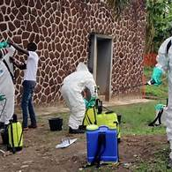
Current Challenges
Les défis rencontrés dans la vaccination des professionnels de santé et des travailleurs de première ligne
L'hésitation à la vaccination, ou l'état d'indécision et d'incertitude concernant la vaccination, est devenue une menace croissante pour la santé publique à l'échelle mondiale.
L'hésitation à la vaccination est complexe, spécifique au contexte et varie selon le moment, le lieu et le type de vaccin.
Influencée par de nombreux facteurs: la confiance dans la sécurité et l'efficacité du vaccin, les connaissances et la sensibilisation du public,
Les facteurs religieux, culturels, sexistes ou socioéconomiques,
En outre, les déterminants sociaux, tels que la capacité à s'absenter du travail et à se rendre sur les sites de vaccination, et la capacité à s'absenter du travail en raison d'effets secondaires, imposent des contraintes supplémentaires aux personnes qui pourraient autrement accepter la vaccination

Slide 6
Les raisons courantes de l'hésitation à se faire vacciner chez les travailleurs de première ligne et les professionnels de la santé
Préoccupations en matière de sécurité
Effets secondaires perçus
Manque de confiance dans le processus de développement du vaccin
Peur de l'inconnu ou d'une nouvelle technologie vaccinale
Désinformation et rumeurs
Préoccupations concernant l'efficacité du vaccin
Obstacles logistiques ou problèmes d'accès
Croyances personnelles ou religieuses
Facteurs Psychologiques
Communication et soutien continus
Notes:
Safety Concerns:
Addressing Strategy: Provide detailed information about the safety profile of the Ebola vaccine. Highlight that the vaccine has undergone rigorous testing in clinical trials to ensure safety. Emphasize that adverse effects are rare and generally mild, similar to other vaccines.
Perceived Side Effects:
Addressing Strategy: Discuss common side effects of the Ebola vaccine, such as mild fever, headache, or injection site reactions, and reassure frontline workers that these are usually temporary and mild. Provide information on how to manage potential side effects and emphasize the benefits of vaccination outweigh the risks.
Lack of Trust in the Vaccine Development Process:
Addressing Strategy: Explain the transparent and rigorous process involved in developing and testing the Ebola vaccine. Highlight the involvement of international health organizations, regulatory bodies, and independent experts in ensuring vaccine safety and efficacy.
Fear of the Unknown or New Vaccine Technology:
Addressing Strategy: Educate frontline workers about the science behind the Ebola vaccine and its technology. Clarify that while the vaccine may be new to them, the underlying principles and technology used are well-established and have been used successfully in other vaccines.
Misinformation and Rumors:
Addressing Strategy: Combat misinformation by providing accurate, evidence-based information about the Ebola vaccine through trusted sources such as health authorities, reputable organizations, and healthcare providers. Address specific concerns or rumors directly with clear and factual information.
Concerns about Vaccine Effectiveness:
Addressing Strategy: Provide data and evidence demonstrating the effectiveness of the Ebola vaccine in preventing Ebola virus disease. Highlight real-world examples and case studies where vaccination has successfully controlled outbreaks or protected healthcare workers.
Logistical Barriers or Access Issues:
Addressing Strategy: Ensure easy access to vaccination by organizing mobile vaccination clinics, offering flexible scheduling options, or integrating vaccination into routine healthcare services. Address logistical concerns such as time constraints or availability of vaccine doses proactively.
Personal or Religious Beliefs:
Addressing Strategy: Respect individual beliefs and values while providing information on how vaccination aligns with personal and communal health responsibilities. Emphasize that vaccination protects not only the individual but also their patients, colleagues, and community members.
Leadership and Role Modeling:
Addressing Strategy: Highlight the importance of healthcare and frontline workers' leadership in promoting public health and protecting vulnerable populations. Encourage vaccination as a professional responsibility and a commitment to patient safety and community health.
Continuous Communication and Support:
Addressing Strategy: Establish ongoing communication channels to address new concerns or questions that may arise among healthcare and frontline workers. Provide support, resources, and access to reliable information throughout the vaccination process and beyond.

Slide 7
Quelques stratégies pour réduire l’hesitation au sein du personnel de sante
Communication et Sensibilisation : Offrir des sessions de formation régulières (données scientifiques, preuves d’efficacité, procédures de vaccination).
Engagement Direct des Experts Professionnels de Santé : rencontres avec des experts en épidémiologie et en vaccinologie pour répondre directement aux questions du personnel de santé et clarifier les doutes.
Communication Claire et Transparente: Diffuser des Informations Basées sur des Preuves
Renforcement de la Confiance : Construire la confiance dans les systèmes de santé et les autorités sanitaires est essentiel.
Encouragement par des Modèles de Comportement: Promouvoir des Leaders d’Opinion au sein du personnel de santé à se faire vacciner publiquement pour servir de modèle et influencer positivement leurs pairs.
Création de Groupes de Support: Former des Groupes de Discussion : Établir des groupes de discussion ou de soutien où le personnel de santé peut discuter de leurs préoccupations, poser des questions, et recevoir des réponses en groupe.

Slide 8
La vaccination des professionnels de santé renforce la confiance au sein de la communauté
Modèle de Comportement Positif : Les professionnels de santé vaccinés montrent l'exemple en se faisant eux-mêmes vacciner, ce qui peut influencer positivement les comportements des patients et du public en montrant que la vaccination est sûre et recommandée.
Communication et Sensibilisation :
Renforcement de la Crédibilité Les actions et l’engagement du personnel envers la vaccination renforce la crédibilité des messages de santé publique.
Réduction de la Stigmatisation : figures respectées dans la communauté, se vaccinent, cela peut aider à réduire la stigmatisation associée à la vaccination et encourager d'autres membres de la communauté à suivre leur exemple.
Engagement Communautaire : participer à des forums communautaires, des discussions publiques, ou des campagnes de sensibilisation, en partageant leurs propres expériences et en encourageant la vaccination à travers des témoignages personnels.
Gestion des Crises : En période d’épidémie, les professionnels de santé vaccinés peuvent jouer un rôle clé dans la gestion de la crise en fournissant des informations fiables et en travaillant à apaiser les inquiétudes de la communauté, ce qui contribue à maintenir la confiance dans les recommandations sanitaires.
Création de Réseaux de Soutien : collaboration avec d’autres leaders communautaires, groupes religieux ou organisations locales pour promouvoir la vaccination.
Transparence et Ouverture : Partager les résultats de la recherche et les données sur la sécurité et l’efficacité des vaccins ➔contribue à bâtir une relation de confiance avec la communauté.

Slide 9
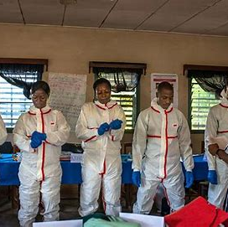
Exemples de stratégies d’engagement communautaire réussies parmi les professionnels de santé/les travailleurs de première ligne
Programmes de formation et de sensibilisation
Engagement avec les dirigeants et les influenceurs locaux
Ateliers et dialogues interactifs
Communication entre pairs
Sensibilité culturelle et adaptation locale: HCD
Utilisation des médias et de la technologie
Incitations et reconnaissance
Notes:
Training and Education Programs: Conducting targeted training sessions and educational programs for healthcare and frontline workers about the Ebola virus, vaccine efficacy, safety, and benefits. These sessions should address any misconceptions or concerns specific to the local context.
Engagement with Local Leaders and Influencers: Collaborating with community leaders, religious leaders, and influential figures who can endorse the vaccine and encourage their communities to get vaccinated. Their support can enhance trust and acceptance of the vaccine among community members.
Interactive Workshops and Dialogues: Organizing interactive workshops, focus groups, and dialogues where healthcare workers can openly discuss their concerns, ask questions, and receive accurate information about the vaccine. This approach promotes two-way communication and addresses specific issues raised by participants.
Peer-to-Peer Communication: Implementing peer education programs where vaccinated healthcare workers share their experiences and advocate for vaccination among their colleagues. Peer-to-peer communication can be highly effective in influencing behavior and fostering a supportive vaccination culture.
Cultural Sensitivity and Local Adaptation: Adapting communication materials and messaging to align with local cultural beliefs, languages, and customs. This ensures that vaccine information is understood and accepted within the community context, enhancing overall engagement and uptake.
Use of Media and Technology: Leveraging local media (radio, television, social media) to disseminate accurate information about the vaccine, address myths and rumors, and promote vaccination campaigns. Using technology such as SMS reminders for vaccine appointments can also improve vaccine uptake among healthcare and frontline workers.
Incentives and Recognition: Providing incentives or recognition programs for healthcare workers who receive the vaccine or actively promote vaccination among their peers. This can encourage participation and reinforce positive behavior towards vaccination.

Slide 10
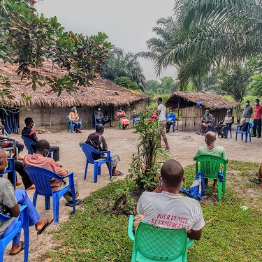
Domaines clés pour messages aux professionnels de santé et travailleurs de 1ere ligne.
Protection contre Ebola
Sécurité et efficacité prouvées
Mesure préventive a l’explosion
Soutien à la continuité des soins de santé
Leadership en santé publique/assurance/confiance
Accès et disponibilité/prêt à faire face à aux épidémies
Informations fiables
Promotion de la santé communautaire
Vigilance/préparation continue aux futures épidémies
Restez informé sur les recommandations et directives
Notes:
Protection Against Ebola: The Ebola vaccine is a critical tool to protect yourself and your patients from Ebola virus disease (EVD). Vaccination reduces your risk of contracting the virus while caring for patients who may be infected.
Proven Safety and Efficacy: Extensive research and clinical trials have demonstrated that the Ebola vaccine is safe and effective. It has undergone rigorous testing to ensure it meets international standards for vaccine safety.
Preventive Measure: Getting vaccinated is a proactive step to prevent the spread of Ebola within healthcare settings. It safeguards your health and the health of your colleagues, patients, and community members.
Support for Healthcare Continuity: By receiving the vaccine, you contribute to maintaining healthcare services during Ebola outbreaks. Vaccinated healthcare workers are less likely to become ill, ensuring continuity of care for patients.
Leadership in Public Health: Your decision to get vaccinated demonstrates leadership in public health and underscores your commitment to protecting the community you serve. It sets an example for patients and colleagues alike.
Access and Availability: The Ebola vaccine is readily available to healthcare workers involved in Ebola outbreak response. Accessing the vaccine is convenient and ensures you are prepared to respond effectively to potential outbreaks.
Trustworthy Information: Seek information from credible sources such as health authorities, international organizations, and reputable medical journals. Address any concerns or questions you may have about the vaccine with healthcare providers or vaccination program coordinators.
Community Health Promotion: Encourage your colleagues and fellow healthcare workers to also get vaccinated. Promoting vaccination within your professional network strengthens overall immunity and protects vulnerable populations.
Continued Vigilance: Even after vaccination, continue practicing infection prevention and control measures recommended by health authorities. This includes wearing personal protective equipment (PPE), adhering to hand hygiene practices, and maintaining vigilance for Ebola symptoms in patients.
Stay Informed: Stay updated on Ebola vaccine recommendations, guidelines, and any new developments in vaccine research and distribution. Your knowledge and preparedness are essential in effectively managing potential Ebola outbreaks.

Slide 11
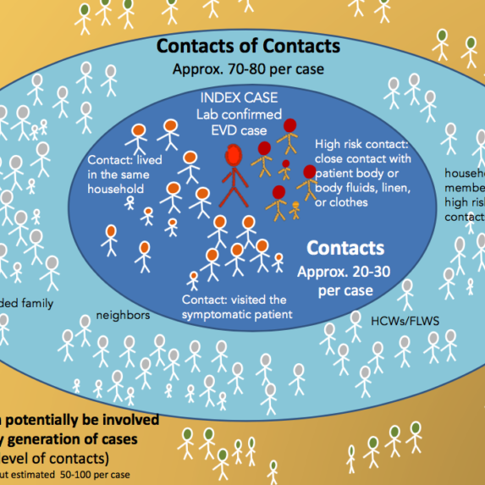
Stratégies pour atteindre et mobiliser efficacement les travailleurs de première ligne
Communication sur mesure
Engagement par l’intermédiaire des dirigeants locaux
Séances de formation et de sensibilisation
Cliniques de vaccination mobiles
Engagement entre pairs
Incitations et reconnaissance
Collaboration avec les employeurs et les organisations
Utilisation de la technologie et des médias sociaux
Événements d'engagement communautaire
Mécanismes de rétroaction
Assistance et suivi continus
Notes:
Tailored Communication: Develop tailored communication materials that are clear, concise, and culturally appropriate. Use simple language and visuals to convey key information about the Ebola vaccine, its benefits, and how to access it.
Engagement through Local Leaders: Utilize local leaders, community influencers, and respected figures to endorse the vaccine and encourage frontline workers to get vaccinated. Their support can enhance trust and acceptance within the community.
Training and Education Sessions: Conduct interactive training and education sessions specifically for frontline workers. Provide comprehensive information about the Ebola virus, vaccination benefits, safety, and efficacy. Address common concerns and questions directly.
Mobile Vaccination Clinics: Set up mobile vaccination clinics that can travel to remote or hard-to-reach areas where frontline workers are based. This approach ensures convenient access to vaccination services, overcoming logistical barriers.
Peer-to-Peer Engagement: Implement peer education programs where vaccinated frontline workers share their experiences and encourage their colleagues to get vaccinated. Peer influence can be a powerful motivator for behavior change.
Incentives and Recognition: Provide incentives or recognition programs for frontline workers who get vaccinated or actively promote vaccination within their communities. This can include certificates, badges, or public acknowledgments of their commitment to public health.
Collaboration with Employers and Organizations: Partner with employers, NGOs, and local organizations that employ frontline workers to facilitate vaccination campaigns. Work together to integrate vaccination into workplace health programs or routine health screenings.
Use of Technology and Social Media: Leverage technology such as SMS alerts, social media campaigns, and online platforms to disseminate information about the Ebola vaccine. Use these channels to reach a broader audience and facilitate appointment scheduling.
Community Engagement Events: Organize community engagement events or town hall meetings where frontline workers can learn more about the vaccine, ask questions, and receive information from healthcare providers. These events promote interactive dialogue and build trust.
Feedback Mechanisms: Establish feedback mechanisms to gather input from frontline workers about their perceptions, concerns, and experiences with the vaccination process. Use this feedback to improve communication strategies and address barriers effectively.
Continuous Support and Follow-up: Provide ongoing support and follow-up to ensure that frontline workers receive their complete vaccination series and understand the importance of follow-up doses or booster shots, if required.

Slide 12
Appel à l'action : Importance des efforts soutenus et de la communication continue
Protection cohérente : des efforts soutenus permettent de garantir que les professionnels de santé et de première ligne reçoivent les vaccins en temps opportun, y compris les rappels si nécessaire.
Lutter contre l'hésitation à la vaccination : une communication continue et taillée sur les problèmes spécifiques permet aux responsables de la vaccination de lutter de manière proactive contre l'hésitation à la vaccination parmi les professionnels de santé et de première ligne.
S'adapter aux défis : Adapter les stratégies de vaccination pour surmonter les défis tels que les obstacles logistiques, la rotation du personnel ou l'évolution des perceptions de la communauté.
Suivi et évaluation : Suivi de la couverture vaccinale et de l'efficacité parmi les professionnels de santé et de première ligne. Une évaluation continue permet d'ajuster les stratégies pour améliorer les résultats et assurer une protection optimale.
Renforcer la résilience : une communication continue favorise une culture de résilience et de préparation au sein des systèmes de santé.

Slide 13
Exemples de materiels de communication pour sensibiliser les professionnels de sante
1. Brochures et Flyers
Contenu : Informations sur l'Ebola, les avantages de la vaccination, la sécurité des vaccins, et des réponses aux questions fréquentes.
Design : Visuellement attrayant, avec des graphiques clairs et des faits précis. Inclure des témoignages de professionnels de santé ayant reçu le vaccin.
2. Affiches
Contenu : Messages clés sur l'importance de la vaccination, le processus de vaccination, et des statistiques sur l'efficacité des vaccins contre l'Ebola.
Design : Utiliser des images percutantes et des bullet points pour transmettre rapidement les informations essentielles. Afficher ces affiches dans les zones de travail des professionnels de santé, telles que les salles d’attente et les bureaux.
3. Vidéos Éducatives
Contenu : Explications détaillées sur le vaccin Ebola, y compris des animations sur le fonctionnement du vaccin, des interviews avec des experts en santé, et des témoignages de professionnels de santé vaccinés.
Design : Courtes (5 à 10 minutes), claires, et accessibles. Disponible sur des plateformes internes de formation ou à travers des séances de formation en ligne.
4. Présentations PowerPoint
Contenu : Diapositives expliquant le besoin de vaccination contre l'Ebola, les avantages du vaccin, les données sur son efficacité et sécurité, et les recommandations des autorités sanitaires.
Design : Visuel avec des graphiques, des données actuelles, et des notes de présentation pour les formateurs. Utilisable lors de réunions, séminaires, ou sessions de formation.
5. Infographies
Contenu : Représentations visuelles des informations clés sur la vaccination contre l'Ebola, y compris des statistiques sur les taux de vaccination et des faits sur le virus.
Design : Clair, concis, et engageant. Utilisable dans des publications internes ou comme support pour des présentations.

Slide 14
Exemples de materiels de communication pour sensibiliser les professionnels de sante
6. Guides de Réponses aux Questions
Contenu : Foire aux questions (FAQ) détaillée répondant aux préoccupations courantes des professionnels de santé sur le vaccin Ebola, telles que la sécurité, les effets secondaires, et l’efficacité.
Design : Document PDF ou papier facile à lire et à consulter rapidement.
7. Newsletters Internes
Contenu : Articles et mises à jour sur la vaccination Ebola, les dernières recherches, et les recommandations des autorités sanitaires.
Design : Format périodique, avec des sections claires et des appels à l'action pour encourager la vaccination.
8. Séances de Formation et Webinaires
Contenu : Sessions interactives avec des experts en épidémiologie et en vaccinologie, couvrant les avantages de la vaccination, la gestion des effets secondaires, et des études de cas.
Design : Offrir des sessions en direct avec la possibilité de poser des questions, ou des enregistrements accessibles en ligne.
9. Témoignages de Professionnels de Santé
Contenu : Témoignages vidéo ou écrits de professionnels de santé ayant reçu le vaccin contre l'Ebola, partageant leurs expériences positives et les raisons de leur choix.
Design : Présenter des témoignages authentiques pour humaniser le message et créer un impact émotionnel.
10. Posters de Conscience Épidémique
Contenu : Informations sur les symptômes de l’Ebola, les risques associés, et comment la vaccination aide à contrôler la propagation.
Design : Visuel et informatif, affiché dans des lieux fréquentés par les professionnels de santé.

Slide 15
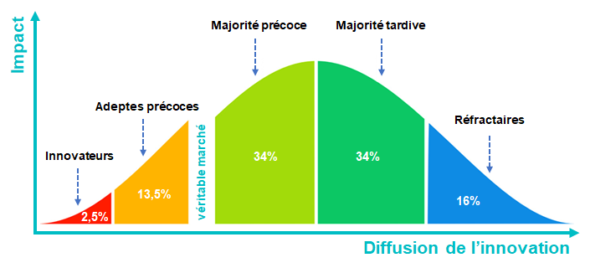
Everett Rogers , théorie de la diffusion de l’innovation, années 60,

Slide 16
Conclusion
En conclusion, des efforts soutenus et une communication continue sont essentiels pour maintenir une couverture vaccinale élevée, relever les défis et renforcer la sécurité sanitaire mondiale contre des maladies comme Ebola parmi les professionnels de la santé ou les travailleurs de première ligne.

Slide 17
Q&R
Espace ouvert pour questions et discussions

Slide 18
Ressources
World Health Organization: WHO Outbreak communication guidelines. 2005. Available at https://www.who.int/publications/i/item/who-outbreak-communication-guidelines
World Health Organization: Communicating risk in public health emergencies A WHO guideline for emergency risk communication (ERC) policy and practice. 2017. Available at https://www.who.int/emergencies/risk-communications
WHO socialNET - https://openwho.org/courses/social-net
Social science in humanitarian action - http://www.socialscienceinaction.org/

